Slide 1
PHYSICS
There is no science in this world like physics…

Slide 2
TOPICS
ELECTRICITY
ENERGY
MOTION

Slide 3
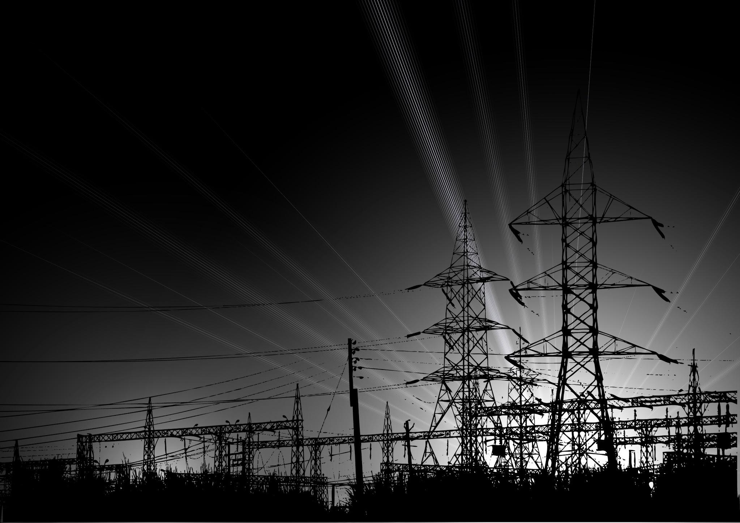
ELECTRICITY
Electricity is the set of physical phenomena associated with the presence and motion of matter possessing an electric charge. Electricity is related to magnetism, both being part of the phenomenon of electromagnetism, as described by Maxwell's equations. Common phenomena are related to electricity, including lightning, static electricity, electric heating, electric discharges and many others.
The presence of either a positive or negative electric charge produces an electric field. The motion of electric charges is an electric current and produces a magnetic field. In most applications, Coulomb's law determines the force acting on an electric charge.

Slide 4
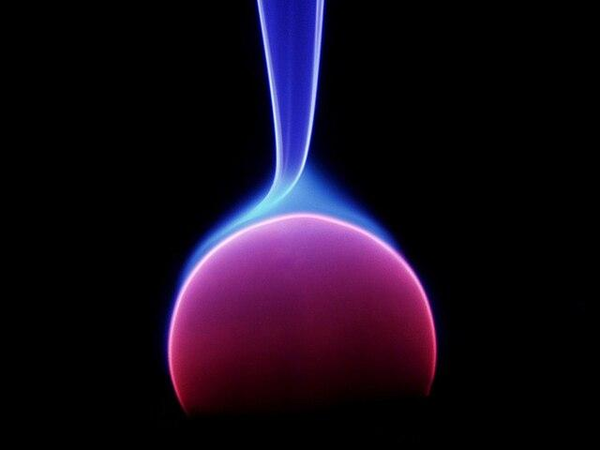
ENERGY
Energy is the quantitative property that is transferred to a body or to a physical system, recognizable in the performance of work and in the form of heat and light.
Forms of energy include the kinetic energy of a moving object, the potential energy stored by an object (for instance due to its position in a field), the elastic energy stored in a solid object, chemical energy associated with chemical reactions, the radiant energy carried by electromagnetic radiation, the internal energy contained within a thermodynamic system, and rest energy associated with an object's rest mass

Slide 5

MOTION
In physics, motion is when an object changes its position with respect to a reference point in a given time. Motion is mathematically described in terms of displacement, distance, velocity, acceleration, speed, and frame of reference to an observer, measuring the change in position of the body relative to that frame with a change in time. The branch of physics describing the motion of objects without reference to their cause is called kinematics, while the branch studying forces and their effect on motion is called dynamics.

